Slide 1
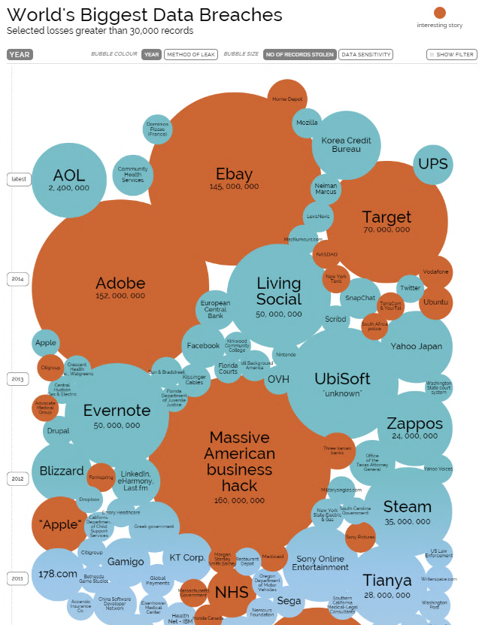
OWASP Web
Vulnerabilities and Auditing
Not just another statistic…

Slide 2
What we are going to cover…
Review of OWASP.org
OWASP Top 10
Web Application Audit Plan

Slide 3
Highlights - 2014 Symantec Internet Security Report
Key Findings
91% increase in targeted attacks campaigns in 2013
62% increase in the number of breaches in 2013
Over 552M identities were exposed via breaches in 2013
23 zero-day vulnerabilities discovered
38% of mobile users have experienced mobile cybercrime in past 12 months
Spam volume dropped to 66% of all email traffic
1 in 392 emails contain a phishing attacks
Web-based attacks are up 23%
1 in 8 legitimate websites have a critical vulnerability

Slide 4
OWASP who , what , why ?
Open Web Application Security Project (OWASP)
Our mission is to make software security visible, so that individuals and organizations worldwide can make informed decisions about true software security risks.
The OWASP Foundation came online on December 1st 2001 it was established as a not-for-profit charitable organization in the United States on April 21, 2004 to ensure the ongoing availability and support for our work at OWASP
advocate approaching application security as a people, process, and technology problem

Slide 5
The OWASP Top 10 - 2013
A1 Injection
A2 Broken Authentication and Session Management
A3 Cross-Site Scripting (XSS)
A4 Insecure Direct Object References
A5 Security Misconfiguration
A6 Sensitive Data Exposure
A7 Missing Function Level Access Control
A8 Cross-Site Request Forgery (CSRF)
A9 Using Components with Known Vulnerabilities
A10 Unvalidated Redirects and Forwards

Slide 6
A1 Injection
Injection means…
  Tricking an application into including unintended commands in the data sent to an interpreter
Typical Impact: SEVERE
  Usually severe. Entire database can usually be read or modified
  May also allow full database schema, or account access, or even OS level access
Security & Risk
Attackers use tools to detect and launch injection attacks that run on the internet 24 / 7. This is often common for application to have a flaw and is hard to detect during normal quality assurance tests for functionality. Exploitability: EASY

Slide 7
A2 Broken Authentication and Session Management
HTTP is a “stateless” protocol
  Means credentials have to go with every request
  Should use SSL for everything requiring authentication
Typical Impact: SEVERE
  User accounts compromised or user sessions hijacked
Security & Risk
Attackers use tools to look for systems that have flaws in the authentication or session management. Attackers look to use trusted accounts to perform action against systems. Typically targeting admin or user who might have a higher level of permissions. Exploitability: AVERAGE

Slide 8
A3 Cross-Site Scripting (XSS)
Occurs any time…
  Raw data from attacker is sent to an innocent user’s browser
Typical Impact: MODERATE
  Steal user’s session, steal sensitive data, rewrite web page, redirect user to phishing or malware site
  Most Severe: Install XSS proxy which allows attacker to observe and direct all user’s behavior on vulnerable site and force user to other sites
Security & Risk
Attacker can craft emails or links in online forms which appear to be valid when looking at the domain but contain coding to infect or steal cookie information. Attackers also try and embed XSS coding into databases which propagate advertisements and or other trusted social media data streams. Exploitability: AVERAGE

Slide 9
A4 Insecure Direct Object References
How do you protect access to your data?
  This is part of enforcing proper “Authorization”, along with
  A7 – Failure to Restrict URL Access
Typical Impact: MODERATE
  Users are able to access unauthorized files or data
Security & Risk
Attacker who is authorized can simply manipulates parameter values to gain access to information. Exploitability: EASY

Slide 10
A5 Security Misconfiguration
Web applications rely on a secure foundation
  Everywhere from the OS up through the App Server
Typical Impact: MODERATE
  Install backdoor through missing OS or server patch
  Unauthorized access to default accounts, application functionality or data, or unused but accessible functionality due to poor server configuration
Security & Risk
Attackers use tools to detect by scanning for services and versions. These tools check patch levels and known vulnerabilities. They even can provide the attack package for any number of attacks or backdoors. Exploitability: EASY

Slide 11
A6-Sensitive Data Exposure
Storing and transmitting sensitive data insecurely
  Failure to properly protect this data in every location
  Failure to identify all sensitive data
  Failure to identify all the places that this sensitive data gets stored Databases, files, directories, log files, backups, etc.
Typical Impact: SEVERE
  Attackers access or modify confidential or private information
    e.g, credit cards, health care records, financial data (yours or your customers)
  Attackers extract secrets to use in additional attacks
  Company embarrassment, customer dissatisfaction, and loss of trust, Expense of the incident, Fines
Security & Risk
Attackers typically don’t break crypto directly. They break something else such as steal the keys or perform man in the middle attacks getting the into after or before encryption. Exploitability: DIFFICULT

Slide 12
A7 Missing Function Level Access Control
How do you protect access to URLs (pages)?
Or functions referenced by a URL plus parameters ?
  This is part of enforcing proper “authorization”, along with
  A4 – Insecure Direct Object References
Typical Impact: Moderate
  Attackers invoke functions and services they’re not authorized for
  Access other user’s accounts and data
  Perform privileged actions
Security & Risk
Attacker, who is using an authorized system user can change URLs or parameters to run a privileged function. Exploitability: EASY

Slide 13
A8 Cross Site Request Forgery (CSRF)
Cross Site Request Forgery
  An attack where the victim’s browser is tricked into issuing a command to a vulnerable web application
  Vulnerability is caused by browsers automatically including user authentication data (session ID, IP address, Windows domain credentials, …) with each request
Typical Impact: MODERATE
  Initiate transactions (transfer funds, logout user, close account)
  Access sensitive data
  Change account details
Security & Risk
Victims unknowingly perform transactions while having an authenticated session. Adding pins and captcha are ways to try and avoid these attacks. Exploitability: AVERAGE

Slide 14
A9 Using Known Vulnerable Components
Vulnerable Components Are Common
  Some vulnerable components (e.g., framework libraries) can be identified and exploited with automated tools
  This expands the threat agent pool beyond targeted attackers to include chaotic actors
Typical Impact: MODERATE
  Full range of weaknesses is possible, including injection, broken access control, XSS ...
  The impact could range from minimal to complete host takeover and data compromise
Security & Risk
Virtually every application has these issues because most development teams don’t focus on ensuring their components/ libraries are up to date. Exploitability: AVERAGE

Slide 15
A10 Unvalidated Redirects and Forwards
Web application redirects are very common
  And frequently include user supplied parameters in the destination URL
  If they aren’t validated, attacker can send victim to a site of their choice
Typical Impact: MODERATE
  Redirect victim to phishing or malware site
  Attacker’s request is forwarded past security checks, allowing unauthorized function or data access
Security & Risk
User’s have become more accustom to looking at the beginning of a link and the domain. This attack uses a trusted site to redirect to malware when clicked. Exploitability: AVERAGE

Slide 16
Web Application Audit Plan

Slide 17
OWASP Testing Framework v3
Passive Phase
  Information Gathering
Active Phase (9 sub-categories, 66 total controls)
  Configuration Management
  Business Logic Testing
  Authentication Testing
  Authorization testing
  Session Management Testing
  Data Validation Testing
  Denial of Service Testing
  Web Services Testing
  Ajax Testing

Slide 18
OWASP Testing Framework v3
Passive Phase
  Information Gathering
    Robots.txt
    Search Engine Discovery/Reconnaissance
      Google, Bing
    Identify application entry points
      Open Ports (nmap)
    Web Application Fingerprint
      Type and Version of OS (netcat, httprint)
    Application Discovery
      Different Base URLs (http://www.example.com/url1)
      Non-Standard Ports (http://www.example.com:2000/)
      Virtual Hosts (www.example.com, helpdesk.example.com)
    Analysis of Error Codes
      Web Server and Associated Components (OpenSSL, PHP)

Slide 19
OWASP Testing Framework v3
Active Phase (9 sub-categories, 66 total controls)
  Configuration Management
    Appropriate Configurations for Web Server, DB, and OS
  Business Logic Testing
    Bypassing Business Rules and Workflows
  Authentication Testing
    Default User IDs and Passwords, Bypassing Authentication
  Authorization Testing
    Privilege Escalation

Slide 20
OWASP Testing Framework v3
Active Phase (9 sub-categories, 66 total controls)
  Session Management Testing
    CSRF, Session Management
  Data Validation Testing
    Cross Site Scripting (XSS), SQL Injection
  Denial of Service Testing
    Locked User Accounts, Failure to Release Files and/or Memory
  Web Services Testing
  Ajax Testing

Slide 21
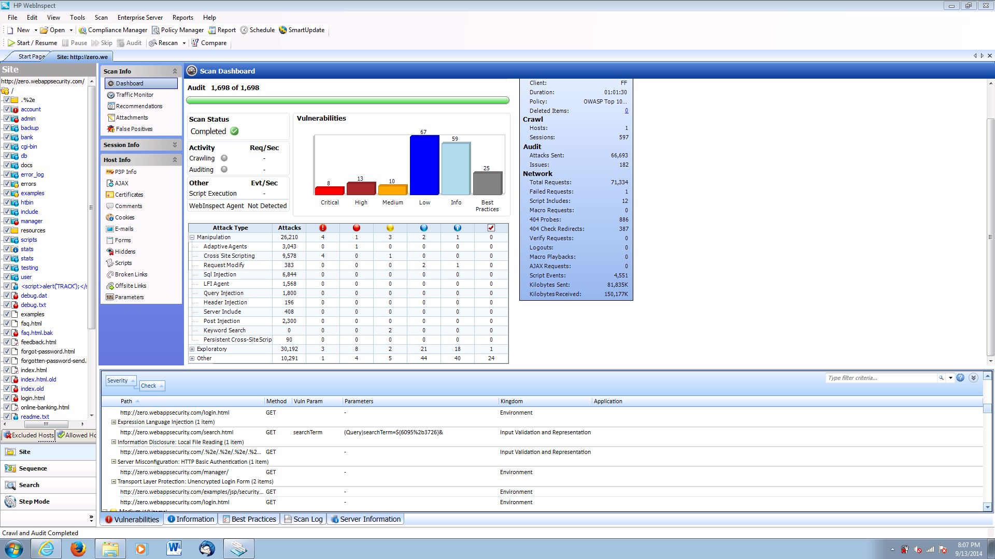
OWASP Testing Framework v3

Slide 22
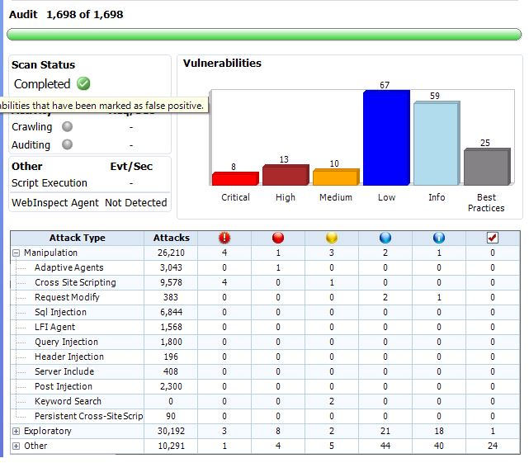
OWASP Testing Framework v3
http://zero.webappsecurity.com

Slide 23
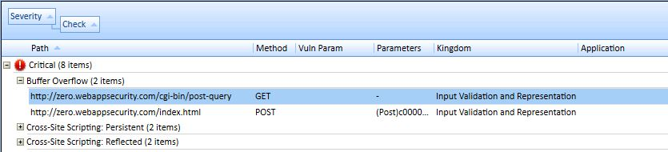
A1 Injection
Deficiency: Post-query script found. A buffer overflow exists in post-query that allows an attacker to gain full access to the system.
Recommendation: Remove the default script from the server.

Slide 24
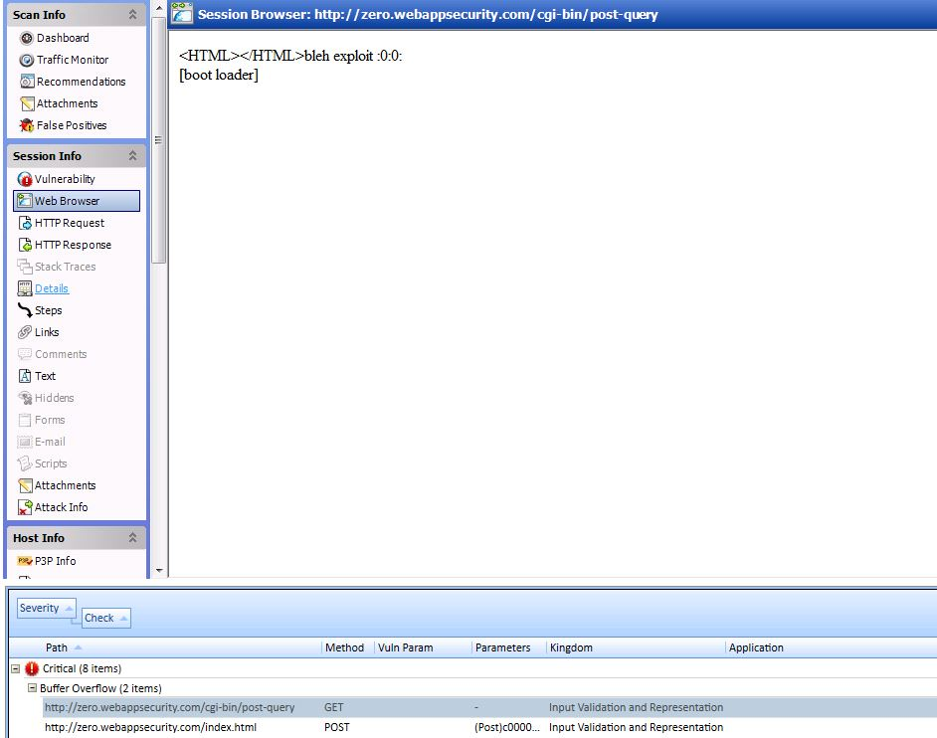
A1 Injection

Slide 25
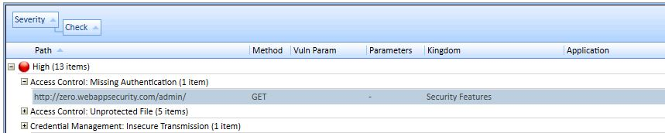
A2 Broken Authentication and Session Management
Deficiency: Access to the privileged remote site administration page does not require authentication.
Recommendation: Restrict access to privileged pages.

Slide 26
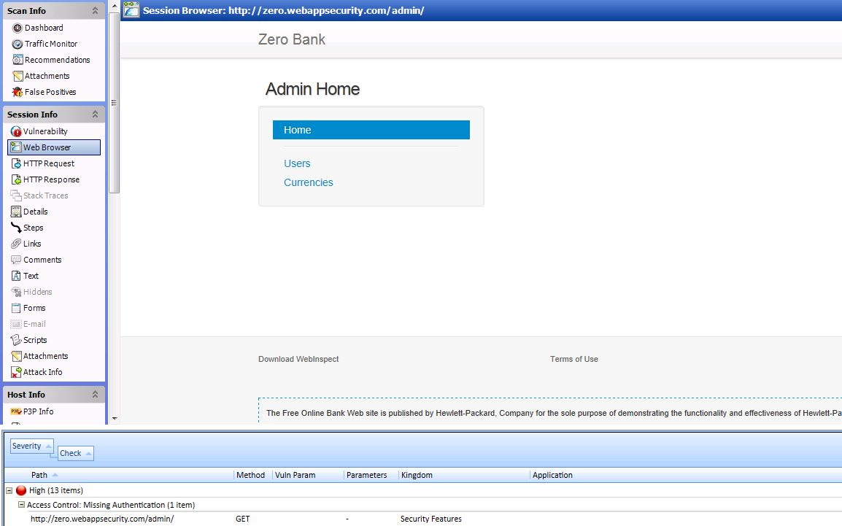
A2 Broken Authentication and Session Management

Slide 27
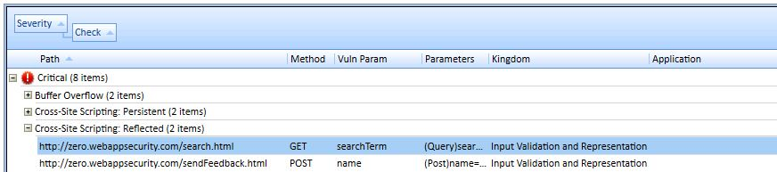
A3 Cross-Site Scripting (XSS)
Deficiency: Cross-Site Scripting vulnerability found in Get parameter “searchTerm” that can allow an attacker to embed malicious scripts in the page and then execute the script on the machine of any user that views the site.
Recommendation: User input should be validation, and encoding all user supplied data to prevent inserted scripts
being sent to end users in a format that can be executed.

Slide 28
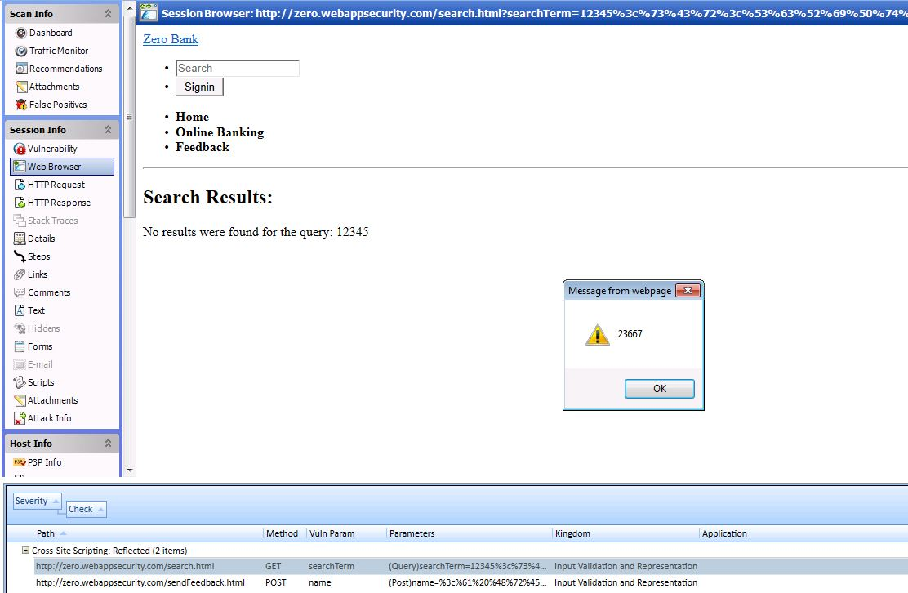
A3 Cross-Site Scripting (XSS)

Slide 29
Resource Links
OWASP - https://www.owasp.org/
CIS - http://www.cisecurity.org/
NIST - http://csrc.nist.gov/
InformationIsBeautiful - http://www.informationisbeautiful.net/visualizations/worlds-biggest-data-breaches-hacks/
Internet Security Threat Report - http://www.symantec.com/security_response/publications/threatreport.jsp

Slide 30
Questions

